Slide 1
Engineering Design DSN2096
By: Akshay Jadhav

Slide 2
Syllabus
Introduction to Engineering design process: Design History; Dieter Rams Principles of Good Design; Overview of Engineering Design Process: Problem Formulation, Concept generation, Project Planning and Design Making; Human Centred Design (HCD);
Design Thinking for Innovation: Design Thinking as Mindset, Process and Toolbox., Enhancing Design Thinking Through, Empathy, Interviewing, Questioning & Brainstorming, Tools for Design Thinking: Mind Mapping, Innovation Flowchart – Question ladder – SCAMPER (for products) Journey Mapping, Task analysis grid (for services)
Engineering Design Approaches: Professional and societal Context of Design; Different types of design – Conceptual, Embodiment designs and Detailed designs – Identification and Specifications, Standards and codes, Design Features – Design for Aesthetics, Production, Standards, Minimum risk, Ease of maintenance, Quality, Minimum cost and Optimum Design, Service Design - People - Asserts - policies - culture. Iterative process - Exploration - Creation - Reflection - Implementation.

Slide 3
Syllabus
Usability & Reliability: Usability – User requirement; User experience; Usability testing; Customer Co-creation; Reliability & Safety: Human and equipment, safety, Risk analysis, and security, System reliability; Use of e-engineering: Modelling, Simulation and Verification.
Prototyping and Visualization: Design Cycle Model, Metaphor method: Theory and methodology of concept generation, Blend method & Thematic Method. Conceptual Design & Design capability and sociality. Prototyping & Visualization Design Tools – E-tools
Sustainable Design: Concepts of sustainable development, Sustainable design principles - Design for Environment; Life Cycle Assessment; Models of sustainable design- Biomimicry, Eco Design, Recycling; Social Innovation
Communication: Articulating design ideas: Storytelling; Sketching & Dynamic Diagrams; K Scripts

Slide 4
Books and resources
TEXT BOOKS:
Huge Jack, “Engineering Design, Planning, and Management” Academic Press, 2013.
Gerhard Pahl, Wolfgang Beitz “Engineering Design: A Systematic Approach” 2014.

Slide 5
Unit3: Engineering Design Approaches

Slide 6
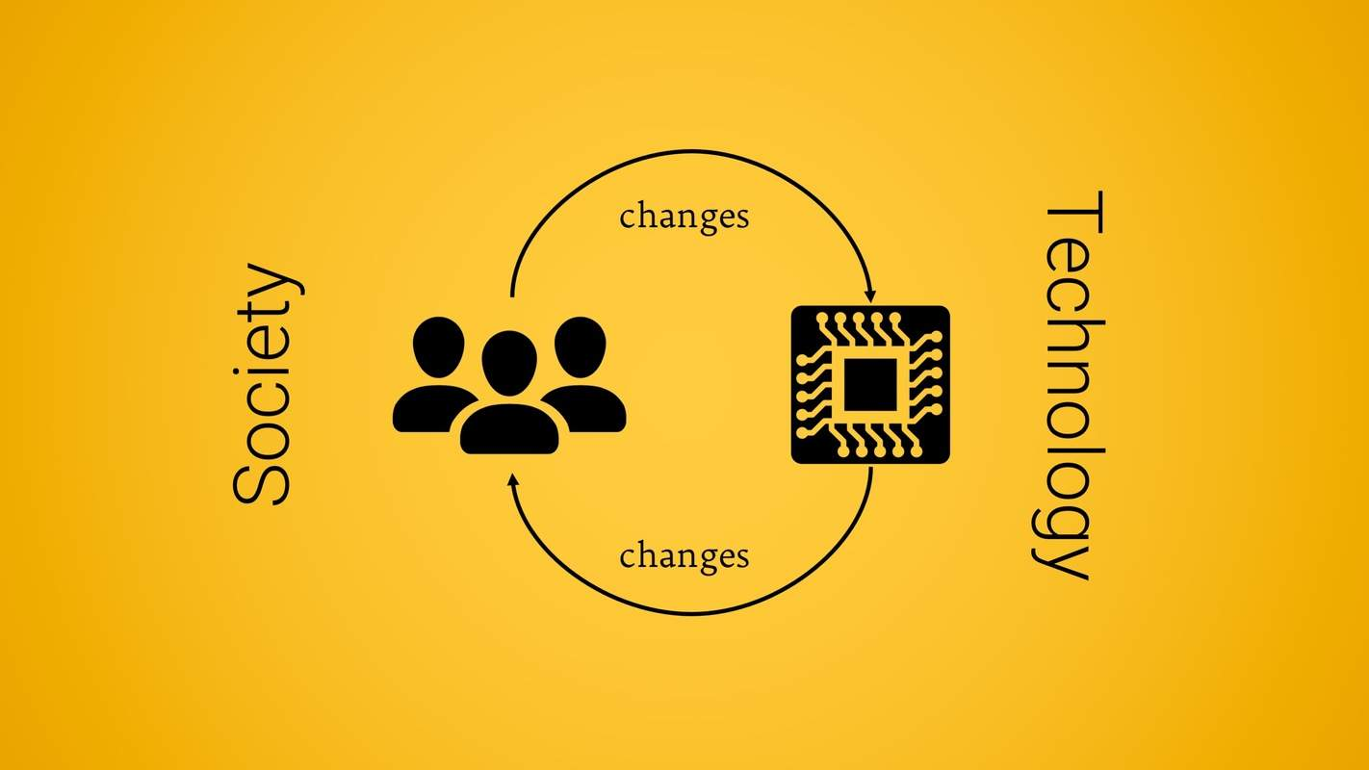
Professional and Societal Context of Design
It is important to understand the role of engineering within our society.
What is a society : A group of humans broadly distinguished from other groups by mutual interests, participation in characteristic relationships, distinct cultural patterns, shared institution, and a common cultural identity.
As a society, we often take technology for granted. However, we must always be aware of its value and shortcomings.

Slide 7
Engineering, Technology and Society
Engineers are the members of society that are engaged in “systematic development of technology, and application of that technology to the benefit of society.”
Your engineering activities can have profound impact on society.
What are the challenges : By the year 2020 the world’s population will approach 8 billion.
Effective use of resources.
Healthcare accessible to different society as per their need.
The Youth Bulge and Security Implications.

Slide 8

Societal Context
It was evident that design requires new methods to apply to the resolution of social issues, and as such, this chapter presents a new method that supports designers in the development of solutions within the design for social innovation (DfSI) framework.
The proposed method consists of six stages:
(1) identifying the challenge,
(2) analyzing the system in which the challenge co-exists,
(3) understanding the system using user-centered design techniques,
(4) defining the design brief,
(5) generating proposals, and
(6) evaluating and concluding.

Slide 9
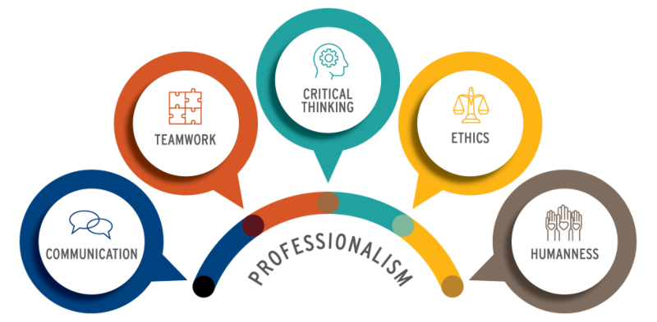
Professionalism
The National Society of Professional Engineers (NSPE) Code of Ethics states,
“Engineering is an important and learned profession. As members of this profession, engineers are expected to exhibit the highest standards of honesty and integrity. Engineering has a direct and vital impact on the quality of life for all people. Accordingly, the services provided by engineers require honesty, impartiality, fairness, and equity, and must be dedicated to the protection of the public health, safety, and welfare. Engineers must perform under a standard of professional behavior that requires adherence to the highest principles of ethical conduct.”

Slide 10
Types of Design

Slide 11
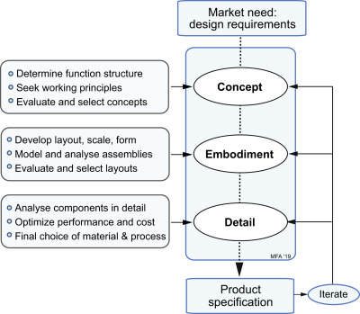
Conceptual Design and Embodiment Design
Three Major Phases
1. Conceptual Design
2. Embodiment Design
3. Detailed Design
Others
4. Planning for Manufacture
5. Planning for Distribution
6. Planning for Use
7. Planning for Retirement of Product

Slide 12
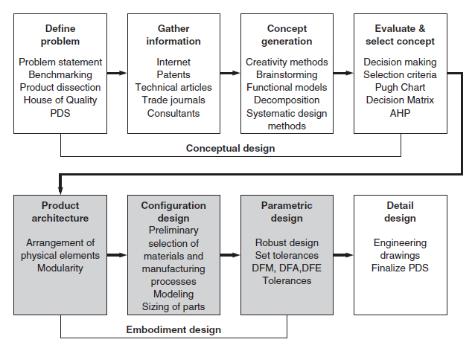
Conceptual Design and Embodiment Design
Embodiment design is also called preliminary design/ system-level
Design.
The term embodiment design comes from Pahland and Beitz and has been adopted by most European and British writers about design.

Slide 13
Design Features
Design for Aesthetics,
Production,
Standards,
Minimum risk,
Ease of maintenance,
Quality,
Minimum cost &
Optimum Design

Slide 14
Detailed Design
Detailed engineering design as the last of three implementation phases in engineering where the first two phases are conceptual and embodiment designs.
In general, detailed engineering design includes the following stages:
Checking specifications. At this stage you ensure that the obtained embodiment design fits all characteristics and conditions of the project.
Defining subsystems, checking, and assembling parts. You must establish subsystem at this stage, divide all parts and components of the product and arrange them in detail, elaborate specifics of their assembling.
Finalizing individual parts and accomplishing technical calculations. You can accomplish these actions as well during conceptual or embodiment designs, however, in the detailed engineering design components and subsystems are finalized and thoroughly verified. At this stage, you prepare the set of manufacturing drawings.
Checking conformity with the standards. At this step you verify all results and ensure that regulations and safety standards are met.
Preparing and reviewing documents. You must prepare, finalize, and review all documents for accuracy as a final step before starting manufacturing of the designed product. Detailed design includes outputs such as 2D and 3D models, plans, detailed and assembly drawings, Bill of Materials, cost estimates, procurement plans etc. Here you identify the full cost of the project.

Slide 15

Design for Aesthetics
Aesthetics is a core design principle that defines a design’s pleasing qualities. In visual terms, aesthetics includes factors such as balance, color, movement, pattern, scale, shape and visual weight. Designers use aesthetics to complement their designs’ usability, and so enhance functionality with attractive layouts.
Aesthetics here refers to the lines, colors, spacing and more on websites and apps, namely what elements you choose and how you apply them.
Ex: Google’s simple design showcases highly effective aesthetics – instantly declaring its purpose as users’ eyes are drawn to the function in the calm, clean layout they expect from Google.

Slide 16
Product Architecture
Product architecture is the arrangement of the physical elements of a product to carry out its required functions.
The product architecture begins to emerge in the conceptual design phase from such things as diagrams of functions, rough sketches of concepts, and perhaps a proof-of-concept model.
However, it is in the embodiment design phase that the layout and architecture of the product must be established by defining the basic building blocks of the product and their interfaces.
The physical building blocks that the product is organized into are usually called modules (often called subsystem, subassembly, cluster, or chunk).
Each module is made up of a collection of components that carry out functions.

Slide 17

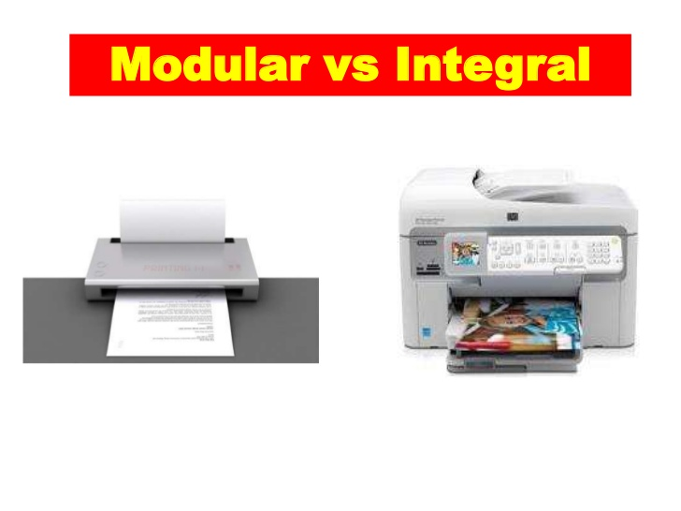
Product Architecture
There are two entirely opposite styles of product architecture: modular and integral.
In a modular architecture, each module implements only one or a few functions, and the interactions between modules are well defined.
In an integral architecture the implementation of functions is accomplished by only one or a few modules.

Slide 18
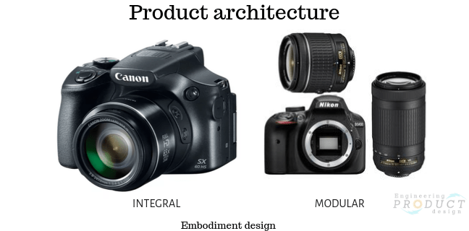
Modular vs Integral
A modular architecture makes it easier to evolve the design over time. It can be adapted to the needs of different customers by adding or deleting modules.
Integral product architecture is often adopted when constraints of weight, space, or cost make it difficult to achieve required performance.

Slide 19
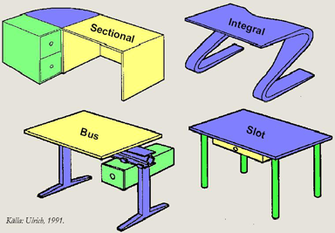
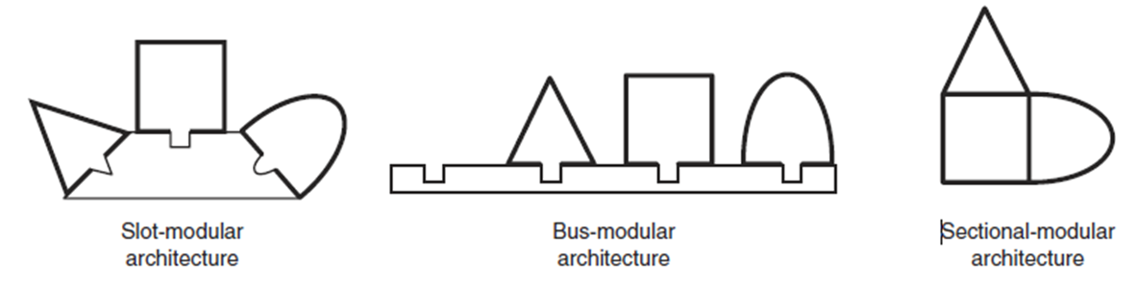
Types of Modular Design
There are three types of modular architectures defined by the type of interface used: slot, bus, and sectional

Slide 20
Engineering Standards
A standard is a document that provides requirements, specifications, guidelines or characteristics that can be used consistently to ensure that materials, products, processes, and services are fit for their purpose.
Standards establish a minimum level of performance and quality control to ensure that optimal conditions and procedures for the purpose of creating compatibility with products and services from different periods and a range of sources.
Engineering standards provide rules and recommendations for
quality, safety, performance and construction, structure, equipment, durability,
codes of practice,
methods of testing, analyzing, appraising, verifying, or measuring, manufacturing, designing, drawing, using, operation of safety condition of production,
symbols and terminology, abbreviations, marks, preferred numbers, or units.

Slide 21
Service Design
Service design is a process where designers create sustainable solutions and optimal experiences for both customers in unique contexts and any service providers involved. Designers break services into sections and adapt fine-tuned solutions to suit all users’ needs in context—based on actors, location and other factors.
The service design focuses on the communication between consumers and the organization during the process of buying or using a physical product or service.
Service Design is about Designing for the Biggest Picture
Only then can you ideate towards solutions for these users’/customers’ specific ecosystems while you ensure brands can deliver on expectations optimally and sustainably.

Slide 22
Service Design
Marc Stickdorn and Jakob Schneider, authors of This is Service Design Thinking, identify five key principles—for service design to be:
User-centered – Use qualitative research to design focusing on all users.
Co-creative – Include all relevant stakeholders in the design process.
Sequencing – Break a complex service into separate processes and user journey sections.
Evidencing – Envision service experiences to make them tangible for users to understand and trust brands.
Holistic – Design for all touchpoints throughout experiences, across networks of users and interactions.

Slide 23
Service Design Thinking: Putting Your Consumer First
Every product is different and has a unique service experience in terms of the type of the product, the service provided, and the persona of the consumer involved in the process.
Therefore, a service design thinking process is required to ensure designing a tailored experience for each consumer segment.
For example, the service design for car selling may vary from one type of cars to another based on the market segment, the luxury car may require a different service model compared with selling an economy car.
The service design thinking process is an iterative process involves four stages: exploration, creation, reflection and implementation.

Slide 24
Service Design Thinking: Putting Your Consumer First
Stage 1: Exploration (Consumer-Centered)
What is the consumer characteristics and culture?
What is the consumer experience before, during and after purchasing the product or service?
What is the existing problems that face the consumer at each touch point?
Stage 2: Creation ( Co-creation model)
This stage involves the collaboration of all stakeholders to plan the service design that will be delivered to the consumer. The main aim of this stage is to formulate the Exploration stage results into an action plan. This stage is very similar to the ideation phase.

Slide 25
Service Design Thinking: Putting Your Consumer First
Stage 3: Reflection (Prototype)
This allows the team to build a prototype that is supposed to improve the consumer experience. It helps to convert the theoretical research results into a tangible solution that can be evaluated and modified in further stages.
The reflection stage is at the heart of the iteration process, if the prototype requires further Exploration or Creation, then the process is returned to the first or the second stage again before building another prototype based on new research results.
Stage 4: Implementation ( Co-creation model)
After applying all the feedback to the prototype and reach a satisfactory stage, the final service is designed and implemented in the system. By this stage, the solution can be tested in its realistic state.
The implementation of the changes in the system should consider the consumer review for this provided service. The collected feedback from consumers can help in the iterative process when improvements are needed again in the future.

Slide 26
UX vs UI Design!
What's the difference? With suitable real world examples.
Assignment

Slide 27
Thanks!

